Slide 1
CIS041-3 Advanced Information Technology
Information Retrieval 2
Term Frequency & Vector Space Retrieval mode
Gangmin Li
(Office hours: 13:00-17:00 every Friday)

Slide 2
What we have learnt
Information seeking:
For decision making. Search and browse, IS and Web
User (needs to query, query to answer), satisfactory
Information Retrieval: Satisfy users info needs.
Information Retrieval
Information Seeking
Match -> Satisfactory

Slide 3
What we have learnt
Document representation and indexing
Term-Document incidence/occurrence Matrix (and many improved variants-number occurrence, position, …)
Indexing (Tokenization, Stopwords elimination, Stemming and Indexing)
Boolean retrieval models
Basic expression: AND, OR and NOT
Exact matching
Based on inverted index of terms, “Merge” two list into one
AND – intersection
OR – Union
NOT – minus

Slide 4
Outline
Ranked Retrieval (why?)
Term frequency (key technology for ranking)
Tf-idf Ranking (best known traditional ranking scheme)
Zipf’s Law (explanation for why it works)
Vector space model: One of the most important formal models for information retrieval (along with Boolean model)

Slide 5
Why Ranked Retrieval?
Improve on Boolean information retrieval mode

Slide 6
Ranked Retrieval
So far, our queries have been Boolean.
Documents either match or don’t.
Good for expert users with precise understanding of their needs and of the collection.
Also good for applications: Applications can easily consume 1000s of results.
Not good for the majority of users
Don’t want to write Boolean queries or wade through 1000s of results.
This is particularly true of web search.

Slide 7
Problem with Boolean search: Feast or famine
Boolean queries often have either too few or too many results. (information sparsity and abundance)
In Boolean retrieval, it takes a lot of skill to come up with a query that produces a manageable number of hits.
In ranked retrieval, “feast or famine” is less of a problem.
Condition: Results that are more relevant are ranked higher than results that are less relevant. (i.e., the ranking algorithm works.)

Slide 8
Scoring as the basis of ranked retrieval

Slide 9
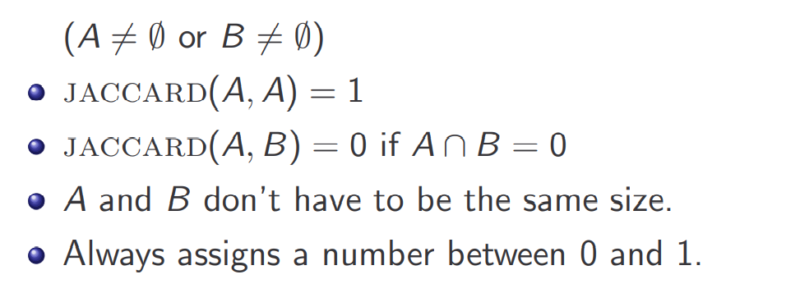
Take 1: Jaccard coefficient
A commonly used measure of overlap of two sets
Let A and B be two sets
Jaccard coefficient:

Slide 10
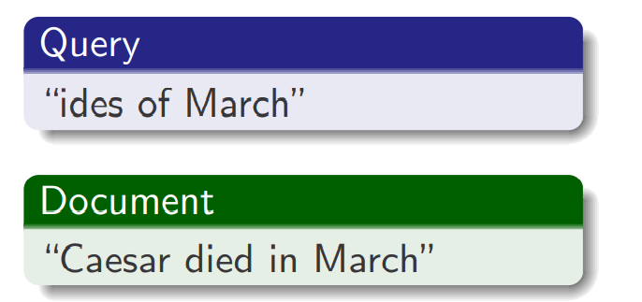
Jaccard coefficient: Example
What is the query-document match score that the Jaccard coefficient computes for:
jaccard(q, d) = 1/6

Slide 11
Issues with Jaccard
It doesn’t consider term frequency (how many occurrences a term has).
It also does not consider that that some terms are inherently more informative than frequent terms (a, the, ...) – term weight
We need a more sophisticated way of normalizing for the length of a document.
Later, we’ll use |A ∩ B|/ $\sqrt{\text{|}\text{A}\text{ ∪ }\text{B}\text{|}}$ (cosine) . . .
. . . instead of |A ∩ B|/|A ∪ B| (Jaccard) for length normalization.

Slide 12
Term Frequency
The key ingredient for ranking

Slide 13
Binary incidence matrix

Slide 14
Count matrix

Slide 15
Bag of words model
We ONLY consider the occurrence of the term NOT the order of words in a document. This is called a bag of words model
Because
Represented the same way
In a sense, this is a step back: The positional index (previous lecture) was able to distinguish these two documents.

Slide 16
Term frequency tf
The term frequency ${tf}_{t,d}$of term t in document d is defined as the number of times that t occurs in d.
We could just use tf as is (“raw term frequency”).
A document with tf = 10 occurrences of the term is more relevant than a document with tf = 1 occurrence of the term.
But not 10 times more relevant.
Relevance does not increase proportionally with term frequency.

Slide 17
Log frequency weighting
Instead of raw frequency, Log frequency weighting is used for more easy (and sensible) measure.
The log frequency weight of term t in d is defined as follows
Occurrence 1 and 1000, one 4 times more in weighting

Slide 18
Score of document-query
We used a matching score to measure the relevance in a query q and a document d pair
Score for a document-query pair is the sum over t in both q and d
The score is 0 if none of the query terms is present in the
document.

Slide 19
Zipf’s Law
if a term is more frequent than it should be?

Slide 20
Frequency in document vs. in collection
Once we know a term frequency in a document,
We may also want to know the term frequency in a collection or in the whole literacy.
Perhaps we may reward terms which are rare in the document collection (why?)
Effectively we are trying to see if a term is more frequent than it should be.
… let us excursion to an important statistical observation about language.

Slide 21
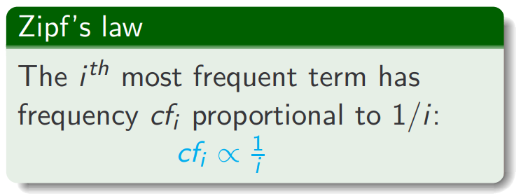
Zipf’s law
How many frequent vs. infrequent terms should we expect in a collection?
In natural language, there are a few very frequent terms and many very rare terms.
${cf}_{i}$is collection frequency: the number of occurrences of the term $t_{i}$ in the collection.

Slide 22
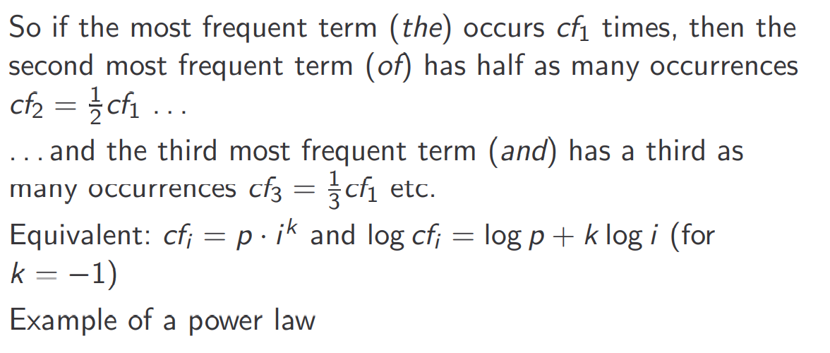
Zipf’s law
K= -1, p = proportional occurrence of the most frequent term
Log is a sensible measure for compression.

Slide 23
Zipf’s Law: Examples from 5 Languages

Slide 24
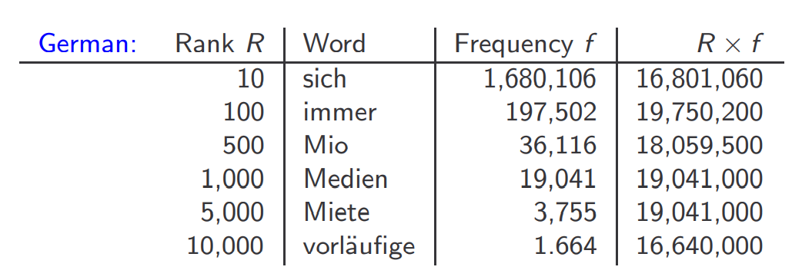
Zipf’s law: Rank × Frequency ∼ Constant

Slide 25
Other collections (allegedly) obeying power laws
Sizes of settlements (city with population)
The number of cities with populations greater than S is proportional to 1/S
Frequency of access to web pages
Income distributions amongst top earning 3% individuals
Korean family names
Size of earth quakes
Word senses per word
Notes in musical performances
. . .

Slide 26
Desired weight for rare terms
Rare terms are more informative than frequent terms.
Consider a term in the query that is rare in the collection (e.g., arachnocentric).
A document containing this term is very likely to be relevant.
→ We want high weights for rare terms like arachnocentric.

Slide 27
Desired weight for rare terms
Frequent terms are less informative than rare terms.
Consider a term in the query that is frequent in the collection (e.g., good, increase, line).
A document containing this term is more likely to be relevant than a document that doesn’t . . .
. . . but words like good, increase and line are not sure indicators of relevance.
→ For frequent terms like good, increase, and line, we want positive weights . . .
. . . but lower weights than for rare terms.

Slide 28
Document frequency
We want high weights for rare terms like arachnocentric.
We want low (positive) weights for frequent words like good, increase, and line.
We will use document frequency to factor this into computing the matching score.
The document frequency is the number of documents in the collection that the term occurs in.

Slide 29
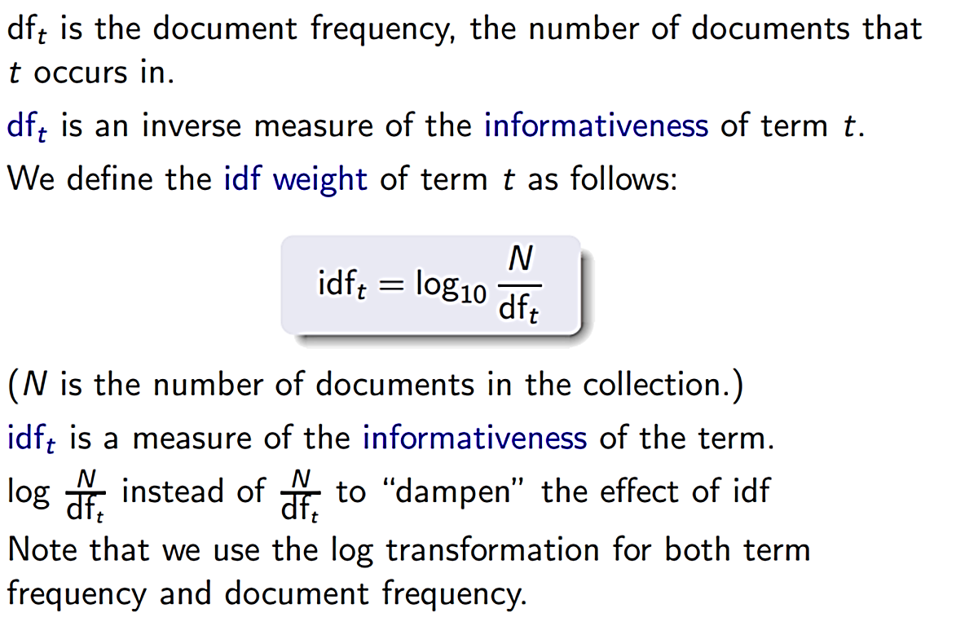
idf weight

Slide 30
Examples for idf

Slide 31
Effect of idf on ranking
idf affects the ranking of documents for queries with at least two terms.
For example, in the query “arachnocentric line”, idf weighting
increases the relative weight of arachnocentric and decreases the relative weight of line.
idf has little effect on ranking for one-term queries.

Slide 32
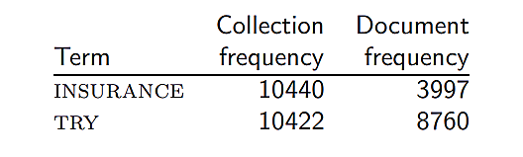
Collection frequency vs. Document frequency
Collection frequency of t: number of tokens of t in the collection
Document frequency of t: number of documents t occurs in
Clearly, insurance is a more discriminating search term and should get a higher weight.
This example suggests that df (and idf) is better for weighting than cf (and icf).

Slide 33
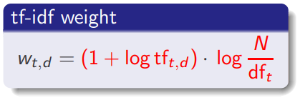
tf-idf weighting
The tf-idf weight of a term is the product of its tf weight and its idf weight.
${tf}_{t.d}=$tf-weight (he number of occurrences of t in document d)
${df}_{t}$= idf-weight (the number of documents containing the term t)
N is the total number of documents in the corpus.
Best known weighting scheme in information retrieval
Alternative names: tf.idf, tf x idf

Slide 34
Interpretation of TF-IDF
The TF-IDF of a term is calculated by multiplying TF and IDF scores.
Translated into plain English, importance of a term is high when it occurs a lot in a given document and rarely in others. In short, commonality within a document measured by TF is balanced by rarity between documents measured by IDF.

Slide 35
Example
A document has 100-word and contains the term “cat” 12 times. The whole collection has 10,000,000 million documents and there are 0.3 million documents that contain the term “cat”. What is the tf-idf score that you are going to assign to “cat”?
“Cat” tf score:
tf = 12 (raw term frequency)
tf = 12/100 = 0.12 (percentage weight)
tf = log12 = 1.08 (log weight)
Document’s idf
IDF (cat) = log (10,000,000/300,000) = 1.52
Document’s if-idf score
W = (1+ log(tf))·log(N/df)= (1+1.08)X1.52 = 3.1616

Slide 36
The vector space model

Slide 37
Binary incidence matrix

Slide 38
Count matrix

Slide 39
Weight matrix

Slide 40
Documents as vectors

Slide 41
Queries as vectors
Key idea 1: do the same for queries: represent them as vectors in the high-dimensional space
Key idea 2: Rank documents according to their proximity to the query
proximity ≈ negative distance
This allows us to rank relevant documents higher than nonrelevant documents

Slide 42
How do we formalize vector space similarity?
First cut: (negative) distance between two points
( = distance between the end points of the two vectors)
Euclidean distance?
Euclidean distance is a bad idea . . .
. . . because Euclidean distance is large for vectors of different lengths.

Slide 43
Why distance is a bad idea

Slide 44
Use angle instead of distance

Slide 45
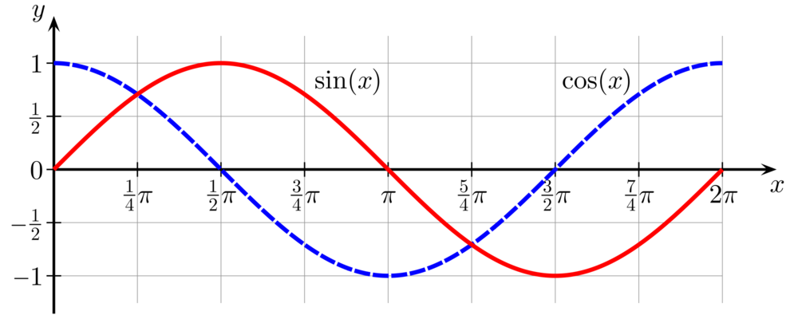
From angles to cosines
The following two notions are equivalent.
Rank documents according to the angle between query and document in decreasing order
Rank documents according to cosine(query, document) in increasing order
Cosine is a monotonically decreasing function of the angle for the interval [0◦ , 180◦ ]

Slide 46
Length normalization

Slide 47
Cosine similarity between query and document

Slide 48
Cosine for normalized vectors

Slide 49
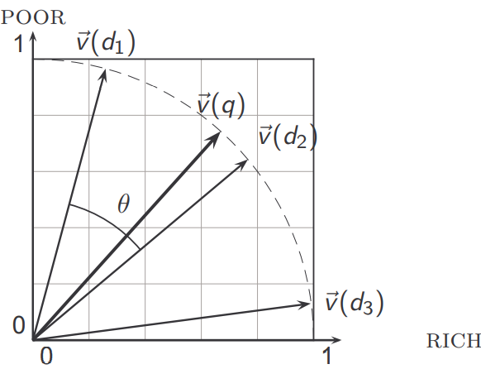
Cosine similarity illustrated

Slide 50
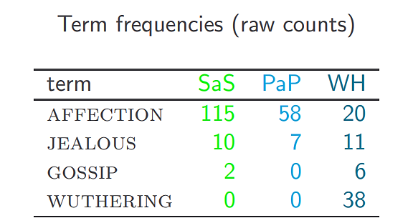
Cosine: Example
How similar are the following novels?
SaS: Sense and Sensibility
PaP: Pride and Prejudice
WH: Wuthering Heights

Slide 51
Cosine: Example
0.789=3.06/$\sqrt{{3.06}^{2}+{2.0}^{2}+{1.3}^{2}}$
(To simplify this example, we don’t do idf weighting.)
cos(SaS,PaP) ≈ (dot product)
0.789 ∗ 0.832 + 0.515 ∗ 0.555 + 0.335 ∗ 0.0 + 0.0 ∗ 0.0 ≈ 0.94.
cos(SaS,WH) ≈ 0.79
cos(PaP,WH) ≈ 0.69
Which two are more similar?

Slide 52
Components of tf-idf weighting

Slide 53
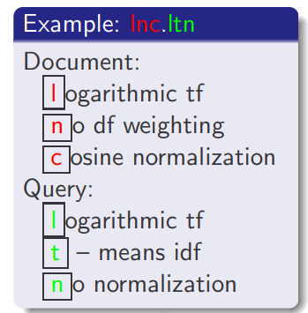
tf-idf example
We often use different weightings for queries and documents.
Normal Notation is: ddd.qqq
Example: lnc.ltn

Slide 54
tf-idf example: lnc.ltn
Query: “best car insurance”. Document: “car insurance auto insurance”.
Key to columns: tf-raw: raw (unweighted) term frequency, tf-wght: logarithmically weighted term frequency, df: document frequency, idf: inverse document frequency, weight: the final weight of the term in the query or document, n’lized: document weights after cosine normalization, product: the product of final query weight and final document weight, N = 1,000,000

Slide 55
Summary
Ranked retrieval in the vector space model
Represent the query as a weighted tf-idf vector
Represent each document as a weighted tf-idf vector
Compute the cosine similarity between the query vector and each document vector
Rank documents with respect to the query
Return the top K (e.g., K = 10) to the user

Slide 56
Reading
Chapter 5.1.2 (Zipf’s Law)
Chapter 6 (Term Weighting)
A beautiful blog (https://towardsdatascience.com/a-gentle-introduction-to-calculating-the-tf-idf-values-9e391f8a13e5)

